Slide 1
Manufacturing Demand N. and S. California
How do we better prepare students for in-demand skills?
Rob Sentz – Chief Innovation Officer

Slide 2
Why? Aligned Economic Ecosystems
REGIONAL ECONOMY
People
Supply
Demand
Higher Ed
Businesses

Slide 3
How? How should we look at this work?
Regional Industries
Resumes / profiles (People)
Curriculum
(Higher Ed)
Job Postings
(Businesses)

Slide 4
What? Labor Market Dynamics
Supply
Locations
Employers
Jobs
Skills
Schools
Local Labor Market
Total employment
Growth / Change
Compensation
Demographics
Education and Training
Courses
Student data
Learning outcomes
Skills/Knowledge
Demand
Locations
Employers
Jobs
Skills
Ed level

Slide 5
5 Ways Higher Ed Should Use Labor Market Analysis
(To Understand) Economic Context and Focus – Becoming an expert on the local economic conditions so you can respond, contribute, and lead.
(To Do) Develop Programs that are Relevant and Valued – Keeping your offerings relevant and aligned. Evaluate / justify new and existing programs.
(To Do) Engage Employers and Community – Using the data to build relationships.
(To Do) Engage Future, Current, and Past Students – Helping people understand the connection between education and work and your value.
(To Do) Communicate Outcomes and Impact – Know the impact and labor market outcomes of your past students.

Slide 6
The Data

Slide 7
Manufacturing Employment in California

Slide 8
Demographics of Manufacturing Employees

Slide 9
Demographics of Manufacturing Employees

Slide 10
Job Postings by California Manufacturers (Open Positions)

Slide 11
Manufacturing Posting Locations

Slide 12
Manufacturing Posting Activity

Slide 13
Top Companies Posting (California)

Slide 14
Top Cities

Slide 15
Top Titles

Slide 16
Skill Clusters
Exploration of manufacturing (production environment) skills.
A new way to evaluate the shape of work
Getting beyond gov taxonomy and job titles

Slide 17
Notes:
SOURCE: https://www.economicmodeling.com/manufacturing-is-not-dead/

Slide 19
Skills Cluster for Manufacturing: Hybrid Jobs
Traditional – tried and true skills
Automation – ability to use tech associated with automation
Six Sigma – process improvement and lean
GMP – quality control and assurance
Lesson: Employers are mixing production and engineering.

Slide 20
CA Skills Cluster
Vehicles – specialized cluster for things that move (planes, cars, etc)
Industrial Design – product design
Six Sigma – Lean manufacturing
GMP - Biotech and food production QA

Slide 21
Human Skills in Manufacturing

Slide 22
Notes:
Four major skill clusters dominate S. CA – GMP./Six Sigma, Automation, Vehicles, Traditional. GMP and Six Sigma exist in every area - esp where we have food production, biotech, pharma, and aerospace.
Notice that many of the production skills and where they are employed and in-demand
Also notice the many engineering skills found in the production environment. This is where we see a real hybridization of production and engineering. The skills are blending together in the same jobs.
We also see a lot of core skills that come from IT/math, the sciences, and even business
In a world of automation, we see a lot of demand for people to master many different aspects of production. There is a lot of upward mobility and transferability with these skills

Slide 23
Notes:
These are the most common skills across all the clusters

Slide 24
Notes:
These are the companies driving the formation of this cluster. Aerospace dominates. There is also a lot of pharma and biotech.

Slide 25
Notes:
In the south engineers are doing GMP. A lot of upward mobility associated with GMP/Six Sigma
These are excellent starting points for work.

Slide 26
Notes:
The north shows some significant differences.
Here automation is the most significant and dominate skill cluster (again – automation isn’t eliminating the need for workers).
GMP/Six Sigma is the second biggest sector and it appears that more technicians are doing this work vs engineering oriented workers in the south.
Ind design is the third strongest cluster and is very associated with product design
Vehicles is fourth – Again CA has a lot of production of things that move.
Energy also showed up as a significant cluster.
There is a strong mix of production and engineering skills
IT/Math, Stats/Analytics/ and the sciences are factor in heavily
These are not basic skills. Very transferable to and high value in the market

Slide 27
Notes:
The core skills look different than the S.
We see a mix of traditional skills and engineering skills.

Slide 29
Notes:
Manufacturing skills in GMP in the North. In the North techs the the GMP
Quality assurance manager
Welding process automation
Continuious process
In the North there is a lot of six sigma, lean and automation are all together. These are engineers
Automation is associated with a lot of robotics.

Slide 30
Questions
Are you familiar with these skill sets?
Are they part of your existing programs?
What gaps exist?
How are we collecting that employer feedback?
How are we collaborating to tweak and move these skills forward?
How are we communicating this to students?

Slide 31
Lawrence Livermore National Lab
Job posting analysis
October 2018 – January 2019

Slide 34
Top Job Titles

Slide 35
Notes:
In Sept 2016 – 700 active postings
In Aug 17 – 1,300
In Nov 17 - 230
In January - 720

Slide 36
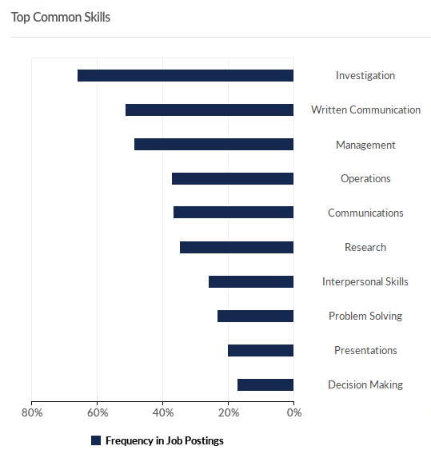

Slide 37
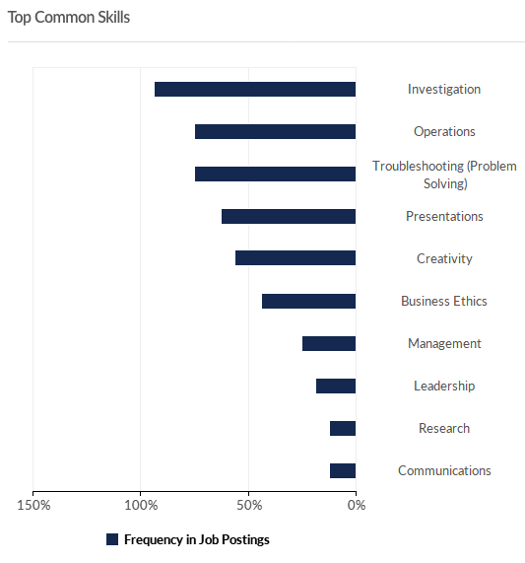
Engineering Tech

Slide 38
Thanks! Questions?
Rob@economicmodeling.com

