Slide 1
STEM Core Team Attendees
Jim Zoval, PI/Alliance Director, Saddleback College
Janet Yowell, PI, University of Colorado Boulder
David Gruber, Director, Backbone Organization, Growth Sector
Gary Barnak, Project Manager, Saddleback College
Kea Anderson, Evaluator, SRI Education
Jared Lessard, Senior Research and Planning Analyst, Saddleback College
This material is supported by NSF Cooperative Grants #HRD-1834628 and #HRD-1834608. Any opinions, findings, and conclusions or recommendations expressed are those of the author(s) and do not necessarily reflect the views of the National Science Foundation (www.nsf.gov). Any opinions, findings, and conclusions or recommendations expressed in this material are those of the author(s) and do not necessarily reflect the views of the National Science Foundation.
Notes:
Presenters: Jim Zoval

Slide 2
STEM Core Alliance Overview
The STEM Core shared vision is to create a pathway that brings underrepresented and underprepared students to a
skill level required for A.S., B.S., and industry employment in STEM fields.
The STEM Core goal is to increase diversity and productivity in the Nation's STEM workplace.
JZ
Notes:
Presenters: Jim Zoval

Slide 3
STEM Core Alliance Overview
The goals of this NSF INCLUDES Alliance are to improve practice related to providing access to STEM education and employment for thousands of underprepared community college students through a networked improvement community approach.
JZ
Notes:
Presenters: Jim Zoval

Slide 4
STEM Core Alliance Overview
The goals of this NSF INCLUDES Alliance are to improve practice related to providing access to STEM education and employment for thousands of underprepared community college students through a networked improvement community approach.
Culturally diverse cohort-based learning communities with intensive student support including a dedicated Student Support Specialist (SSS)
JZ
Notes:
Presenters: Jim Zoval

Slide 5
STEM Core Alliance Overview
The goals of this NSF INCLUDES Alliance are to improve practice related to providing access to STEM education and employment for thousands of underprepared community college students through a networked improvement community approach.
Culturally diverse cohort-based learning communities with intensive student support including a dedicated Student Support Specialist (SSS)
Accelerated and contextualized cohort math courses
JZ
Notes:
Presenters: Jim Zoval

Slide 6
STEM Core Alliance Overview
The goals of this NSF INCLUDES Alliance are to improve practice related to providing access to STEM education and employment for thousands of underprepared community college students through a networked improvement community approach.
Culturally diverse cohort-based learning communities with intensive student support including a dedicated Student Support Specialist (SSS)
Accelerated and contextualized cohort math courses
Opportunity for paid internships for STEM Core completers
JZ
Notes:
Presenters: Jim Zoval

Slide 7
STEM Core Alliance Overview
The goals of this NSF INCLUDES Alliance are to improve practice related to providing access to STEM education and employment for thousands of underprepared community college students through a networked improvement community approach.
Culturally diverse cohort-based learning communities with intensive student support including a dedicated Student Support Specialist (SSS)
Accelerated and contextualized cohort math courses
Opportunity for paid internships for STEM Core completers
Professional development for faculty and counselors
JZ
Notes:
Presenters: Jim Zoval

Slide 8
STEM Core Alliance Overview
The goals of this NSF INCLUDES Alliance are to improve practice related to providing access to STEM education and employment for thousands of underprepared community college students through a networked improvement community approach.
Culturally diverse cohort-based learning communities with intensive student support including a dedicated Student Support Specialist (SSS)
Accelerated and contextualized cohort math courses
Opportunity for paid internships for STEM Core completers
Professional development for faculty and counselors
Sharing best practices and solutions
JZ
Notes:
Presenters: Jim Zoval

Slide 9
Changing People’s Lives by Changing Systems
Culturally diverse cohort-based learning communities with intensive student support including a dedicated Student Support Specialist (SSS)
Accelerated and contextualized cohort math courses
Opportunity for paid internships for STEM Core completers
Professional development for faculty and counselors
Sharing best practices and solutions
JZ
Notes:
Presenters: Jim Zoval

Slide 10
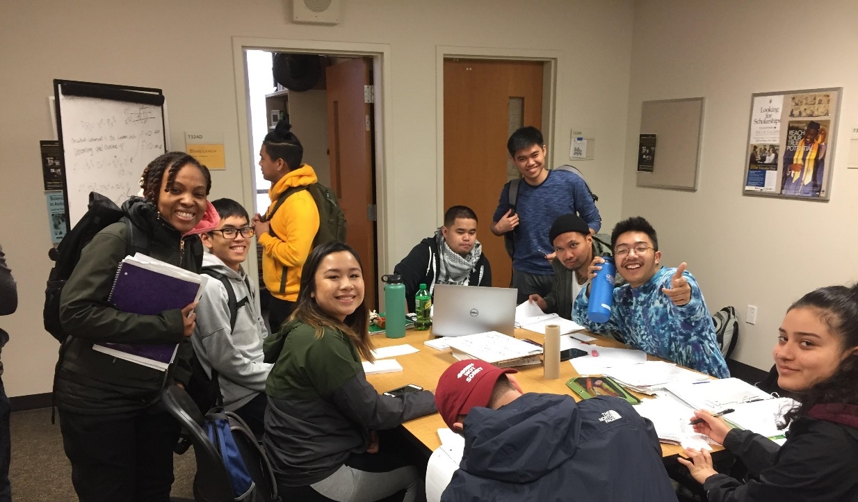
Changing People’s Lives by Changing Systems
Changing the “college experience” by facilitating a supportive, second family for students
Culturally diverse cohort-based learning communities with intensive student support including a dedicated Student Support Specialist (SSS)
JZ
Notes:
Presenters: Jim Zoval

Slide 11
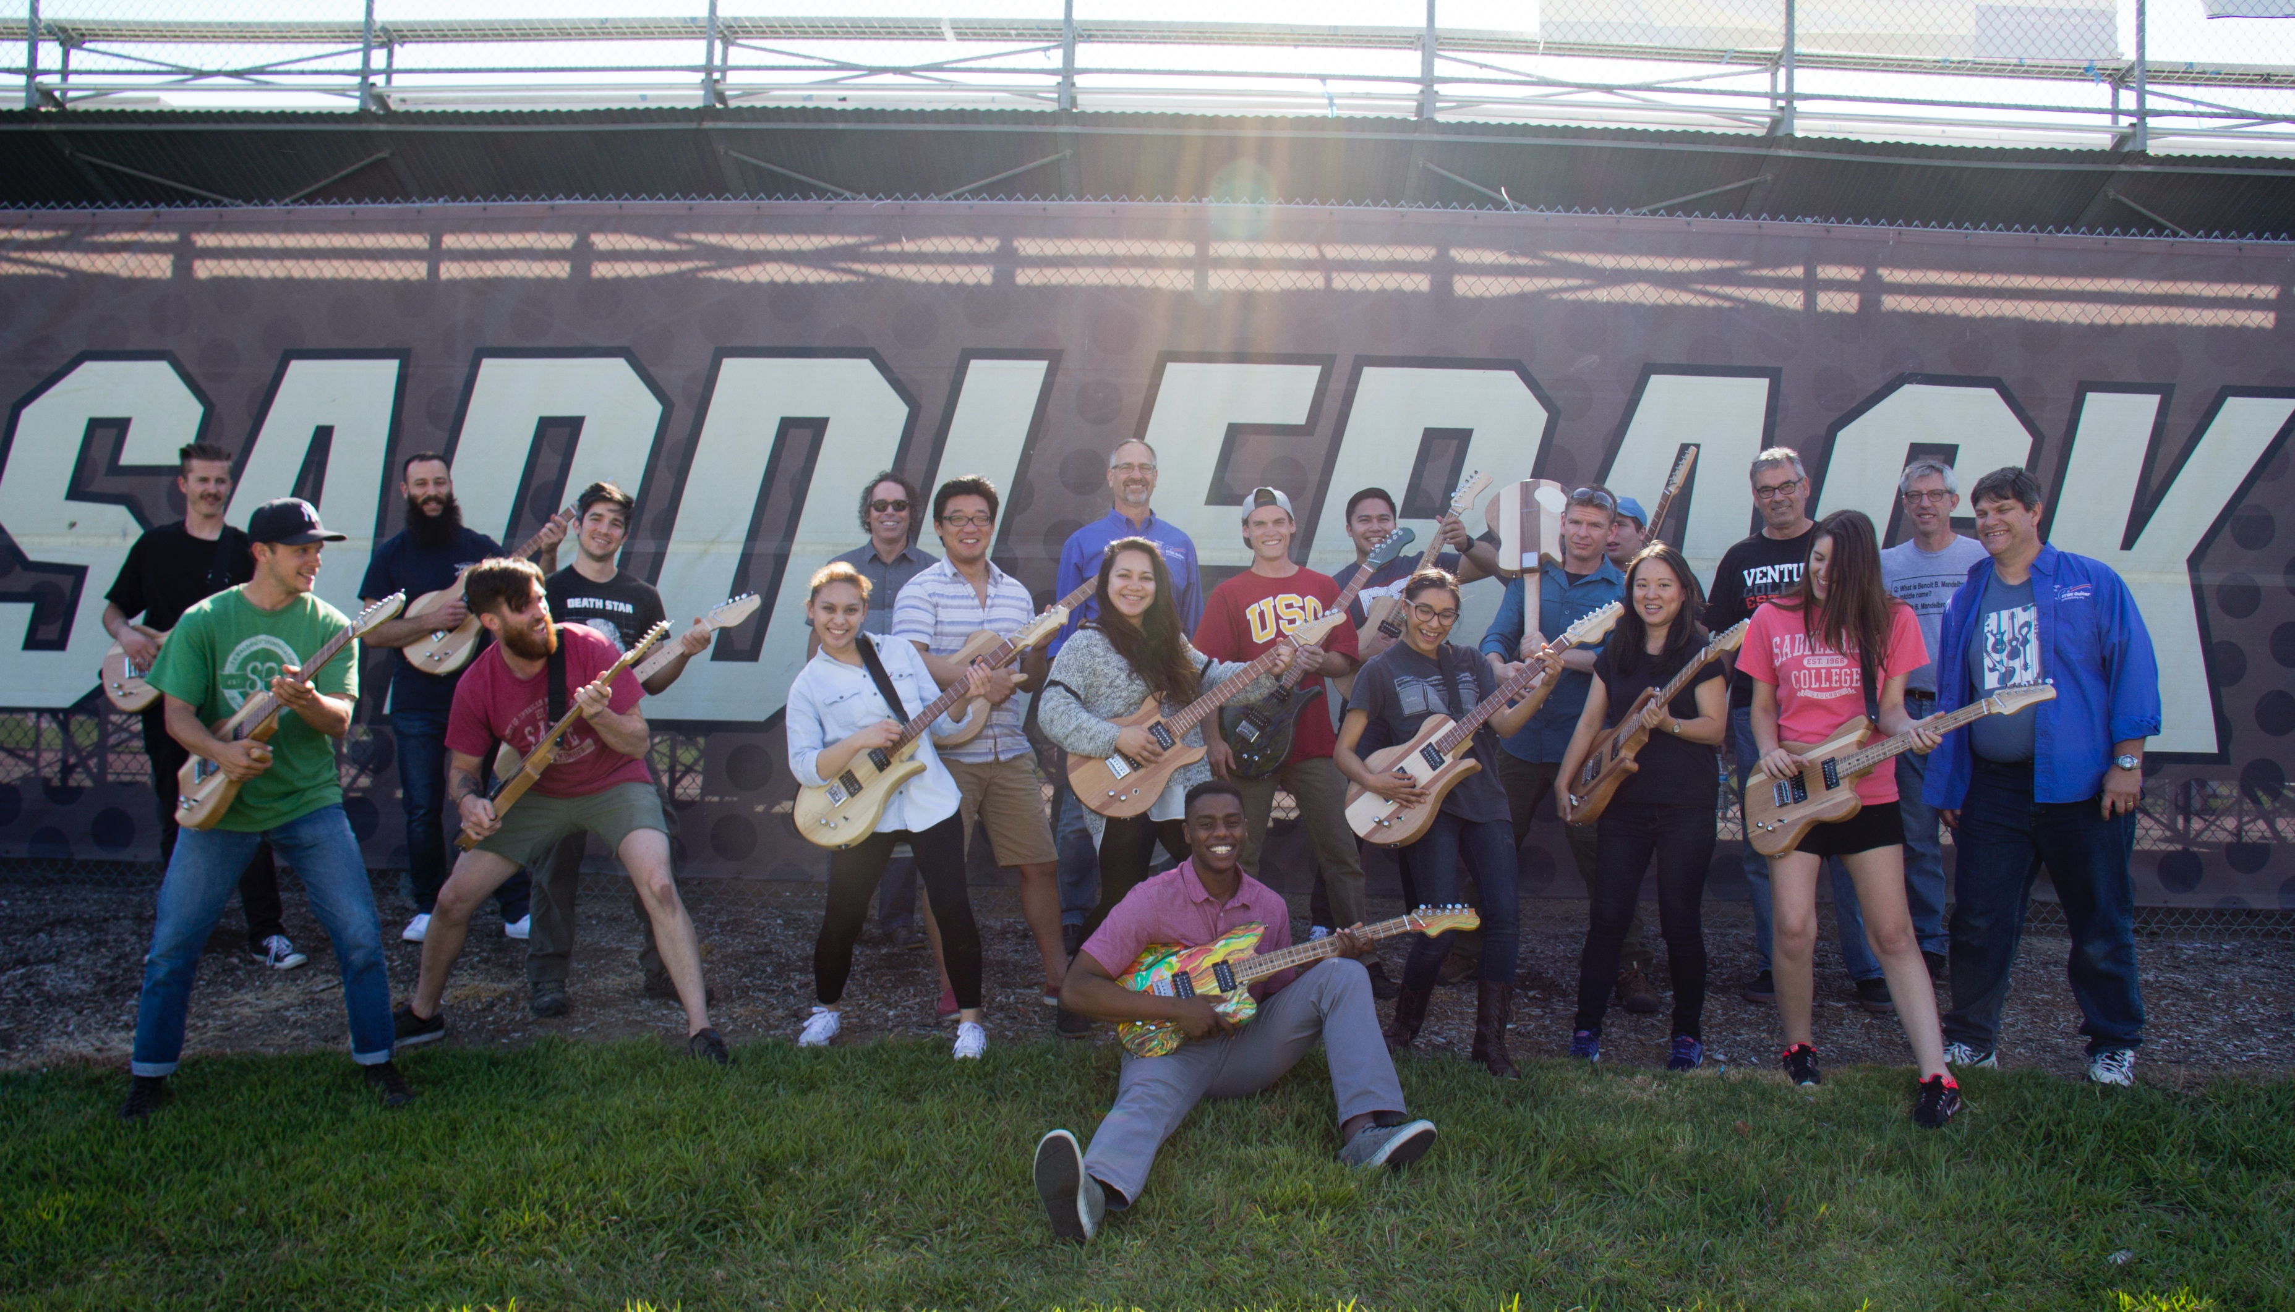
Changing People’s Lives by Changing Systems
Changing the way colleges deliver math courses
Accelerated and contextualized cohort math courses
JZ
Notes:
Presenters: Jim Zoval

Slide 12
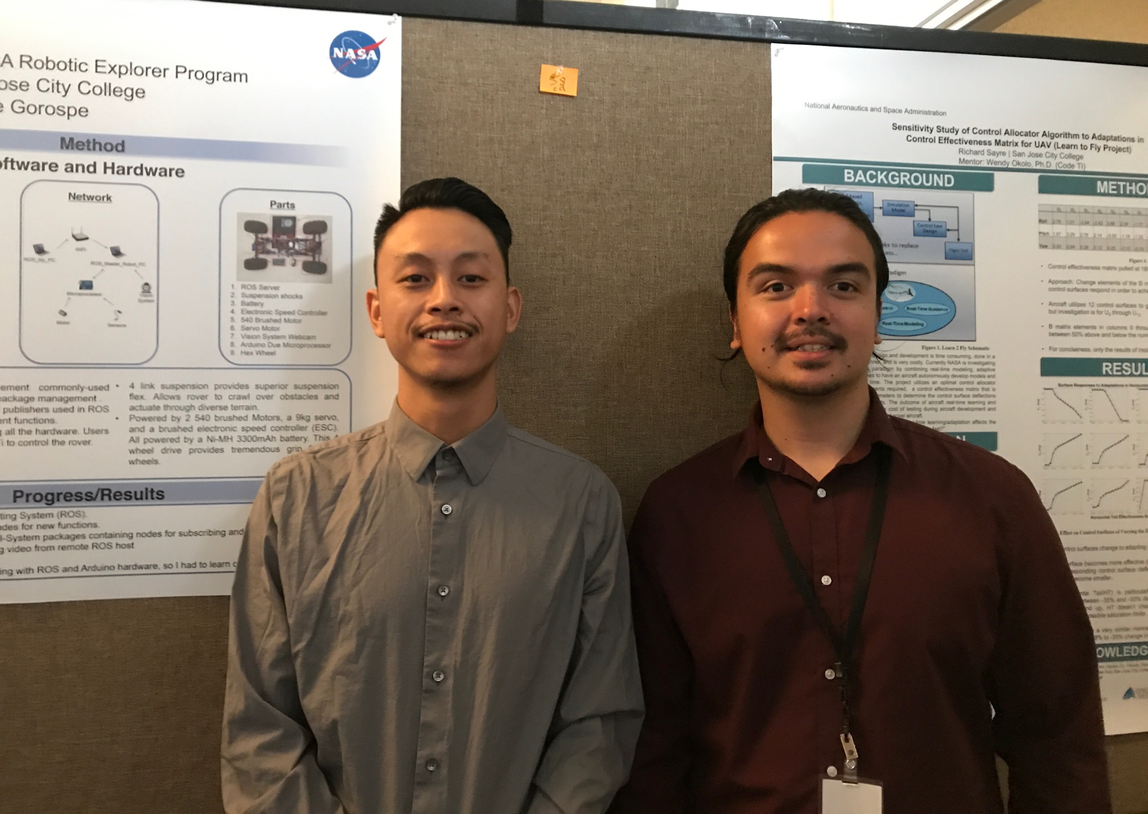
Changing People’s Lives by Changing Systems
Changing the way employers view internships
Opportunity for paid internships for STEM Core completers
JZ
Notes:
Presenters: Jim Zoval

Slide 13
Changing People’s Lives by Changing Systems
Changing the way faculty and counselors view student potential
Professional development for faculty and counselors
JZ
Notes:
Presenters: Jim Zoval

Slide 14
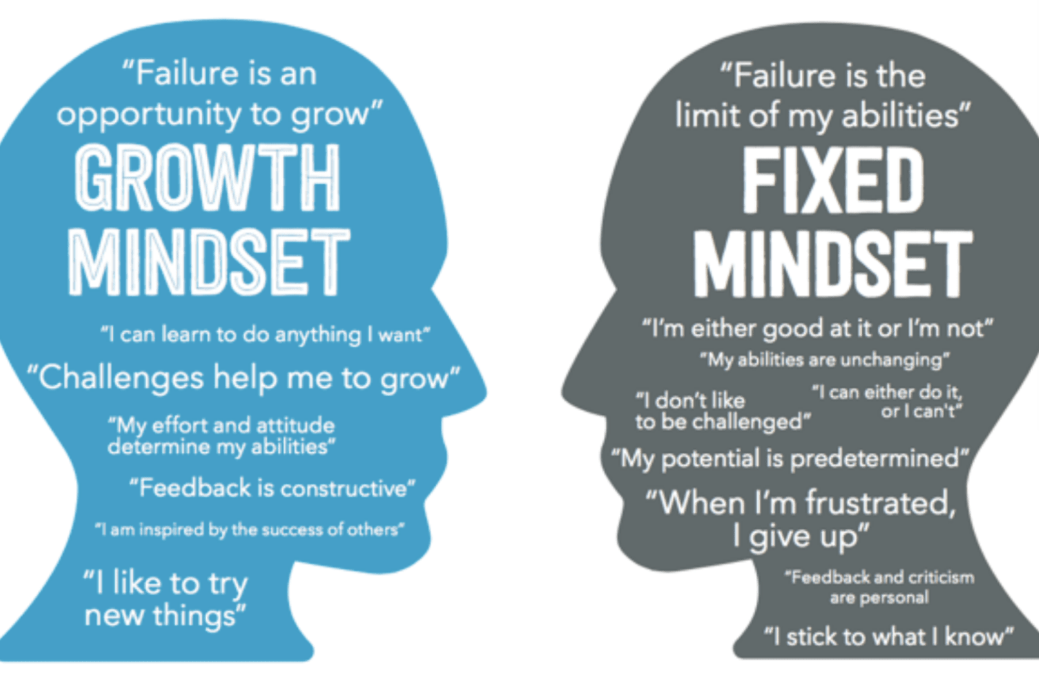
Changing People’s Lives by Changing Systems
Sharing best practices and solutions
JZ
Notes:
Presenters: Jim Zoval

Slide 15
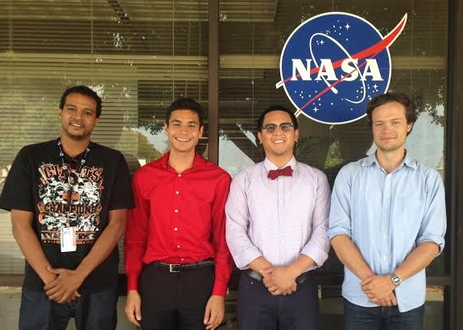
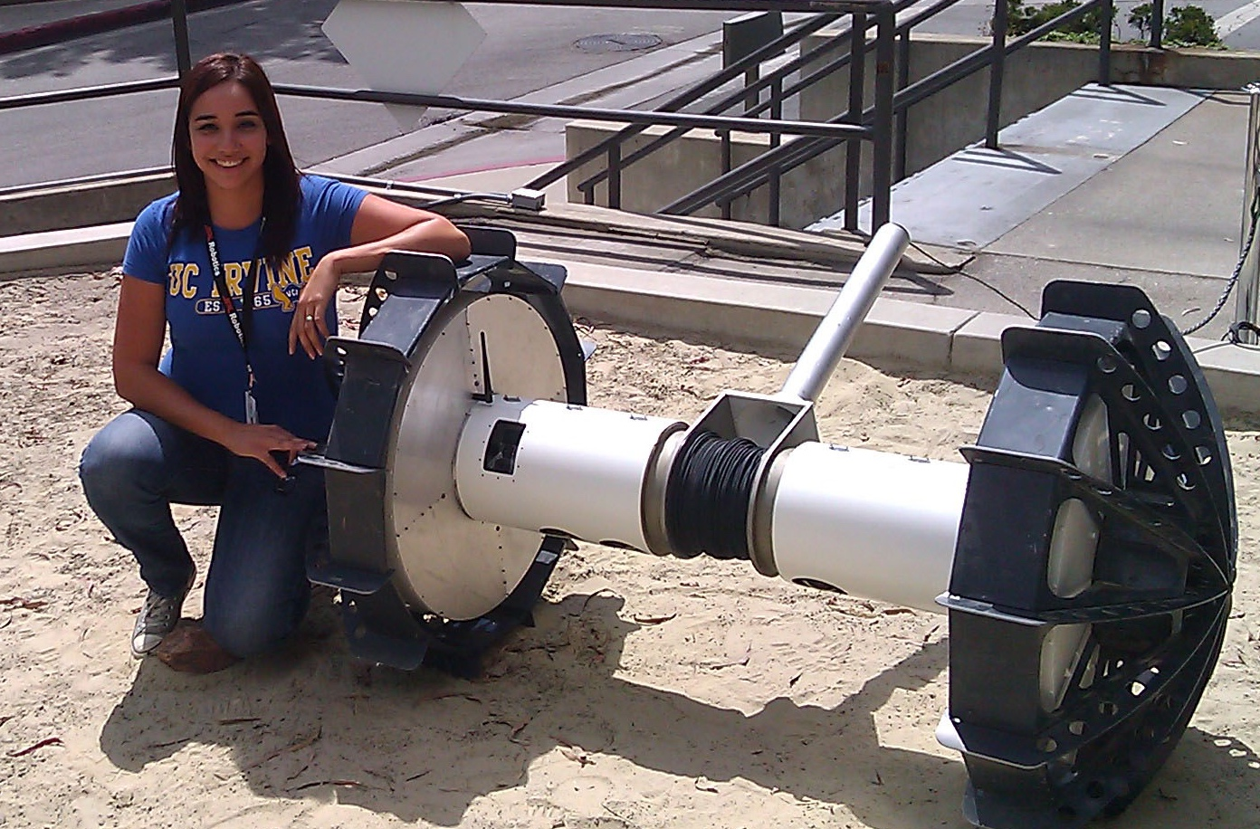
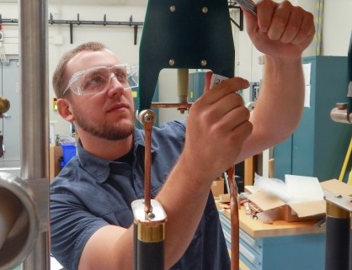
The STEM Core Model
Details, Infrastructure, and Partnerships
DG

Slide 16
The Challenge
Mismatch between expanding engineering and computer science employment and next-generation (community college) workforce pool
Core Skills for Employment and STEM Degrees
Barriers
Calculus readiness
Computational thinking and foundational level programming/Engineering Graphics and CAD
English and communication proficiency
60%-80% of students entering community college place into developmental math
Lack of clear community college pathways to STEM degrees
Lack of understanding of STEM career opportunities
Lack of role models/professional network
Fear of math
Lack of academic, social, financial support
Low expectations
DG

Slide 17
STEM Core Strategy
Traditional Math Path
STEM CORE Year
1 course per semester
No link to career
No contextualization to other courses
No experiential learning
Individual enrollment
Limited support
TIME TO CALCULUS = 2 – 2 ½ YEARS
Accelerated math-focused curriculum encompassing 3-4 courses
Curriculum contextualized to science and engineering careers and learning
Introduction to Programming class (or other STEM)
Cohort-based learning community
Wrap-around student support
Paid internship opportunities
TIME TO CALCULUS = 9 MOS – 1 YEAR
Average 3-year progression from Intermediate Algebra to Calculus = 4%
OUTCOMES:
Average 2-semester progression from Intermediate Algebra to Calculus = 64%
1,400+ students served
250+ placed into internships
DG

Slide 18
STEM Core Engineering Technologist Pathway
YEAR 1
Coursework
Algebra
Trigonometry
Pre-calculus
Intro to Electricity and motors
Intro to Engineering (projects including soldering and circuits, and robotics/Intro to manufacturing)
CAD and blueprint reading
Support
Internship Prep (resume, interviews, etc.)
Guest speakers from industry
Employer site visits
SUMMER
Engineering Internships
Hands-on, work experience on-site with employers
10 weeks, 40 hours per week
$15 per hour
YEAR 2
Coursework
Physics
Material science
Technical Coursework:
Additional Blueprint Reading/CAD
Statics
To be determined…
B.S. degree pathway,
full-time employment
Full-time Employment
Employer-sponsored Apprenticeships 20 hours/week
Year 1 + Internship = “Pre-Apprenticeship”
Apprenticeship
DG

Slide 19
STEM Core Network
Partners
Community College Partners:
Community College Partners:
Saddleback College (CA)
Cañada College (CA)
City College of San Francisco
East Los Angeles College (CA)
Evergreen Valley College (CA)
Grossmont College (CA)
Las Positas College (CA)
Merritt College (CA)
Mission College (CA)
Ohlone College (CA)
Palomar College (CA)
San Diego Mesa (CA)
San Jose City College
Santa Ana College (CA)
Skyline College (CA)
West Valley College (CA)
Community College of Aurora (CO)
Pikes Peak Community College (CO)
Red Rocks Community College (CO)
Santa Fe Community College (NM)
Northern New Mexico College (NM)
Anne Arundel Community College (MD)
Howard Community College (MD)
The Community College of Baltimore County (MD)
Central Seattle Community College (WA)
Highline Community College (WA)
South Seattle Community College (WA)
Valley High School (CA)
Gallup McKinley Academy (NM)
Digital Harbor High School (MD)
Employer Partners:
NASA Jet Propulsion Lab
NASA Ames Research Center
NASA Goddard
Lawrence Livermore National Lab (LLNL)
Lawrence Berkeley National Lab (LBNL)
Los Alamos National Lab (LANL)
Sandia National Lab
Stanford Linear Accelerator Lab (SLAC)
BD Bio Sciences
Blach Construction
California Dept. of Transportation (Caltrans)
Communications and Power Industries
Jabil
Lam Research
Leidos
Lockheed Martin
Malware Bytes
Mathews Mechanical
Northrop Grumman
SAP Software
Silicon Valley Bank
Symantec
TRC Solutions
VM Ware
Varian
Zoox
Fort Mead Alliance (employer association)
Silicon Valley Leadership Group (employer association)
DG

Slide 20
STEM Core Network
STEM Core is currently developing STEM pathways to careers at five national labs: Lawrence Livermore, Sandia, Los Alamos, Stanford Linear Accelerator and Oak Ridge;
Pathways build on STEM Core college and dual credit programs, include visits and presentations, and lead to internships and potential employment in engineering and computer science;
STEM Core is seeking funding support from the Department of Energy to expand this effort including a direct focus on partner minority serving institutions.
DG

Slide 21
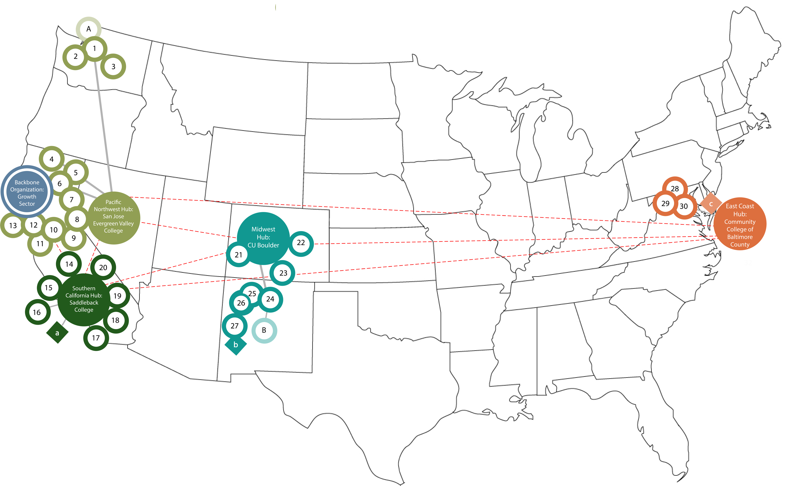
National STEM Core Academic Network
DG

Slide 22
STEM Core Collaborative Infrastructure
Saddleback College
Jim Zoval, PI/Alliance Director
Art Nitta, Co PI
University of Colorado Boulder
Janet Yowell, PI
Backbone Organization
Dave Gruber and
Caz Pereira, Directors
Gabe Hanzel-Sello, National STEM Director
SSS training, securing internships, adding college partners, high school dual credit, and program institutionalization
Professional Development for
Faculty and Counselors
(Stanford)
Evaluation Team
SRI Education
(Kea Anderson)
Southern California Hub
Saddleback College
East Coast Hub
Community College of Baltimore County
Pacific Northwest Hub
San Jose Evergreen Valley College
Midwest Regional Hub
University of Colorado Boulder
Hub Coordinator
Hub Coordinator
Hub Coordinator
Hub Coordinator
College Participants
East LA
Grossmont
Palomar
Saddleback
San Diego Mesa
Santa Ana
College Participants
Anne Arundel
Howard Community College
The Community College of Baltimore County
College Participants
Cañada College
Central Seattle
City College of San Francisco
Evergreen Valley
Highline
Las Positas
Merritt
Mission
Ohlone
San Jose City
Skyline
South Seattle
West Valley
College Participants
Aurora
Red Rocks
Pikes Peak
Santa Fe
Northern New Mexico College
University of New Mexico, Gallup
University New Mexico, Los Alamos
National Labs
Employers and Workforce Investment Boards
DG

Slide 23
STEM Core Management Structure
General Programmatic Management Structure
University of Colorado
(Janet Yowell)
Saddleback College
(Jim)
Saddleback College (Art, Gary)
Academic
Publications
(Art, Gary)
Develop the data infrastructure to monitor and respond to emerging network needs, and monitor data for continuous improvement.
(Growth Sector)
Web Site Programmatic Content and Function
(Art, Gary)
NSF Reports
(Jim/Gary)
Non Academic Data Collection and Analysis
(Evaluation Team)
Growth Sector
Support Saddleback Team as Needed
All Hubs
(support growth sector’s efforts and implement recommended improvements)
Web site technical
(Jim/Gary/Manny)
Growth Sector, Stanford, Hubs, Evaluation Team, and College Partners
Support Saddleback Team as Needed
Stanford, Hubs, Evaluation Team, and College Partners
Support Saddleback and Growth Sector Teams as Needed
Student Academic Data Collection and Analysis
(Jared, Jim, Art)
All Hubs
(manage data collection at partner colleges)
Publication Preparation
Co-Authors
Jared, Roxanne, Art, Gary, Dave, Caz, M. Venn,
SC faculty members,
Manny, Cathy
All Partner Colleges
(collect and submit academic data to HUB coordinator)
JZ

Slide 24
STEM Core Management Structure
Contracts, Accounting, Invoicing, Purchasing, Public Relations, and Compliance
Saddleback College
(Roxanne)
Contracts and Contract Invoicing
(Gary/ Roxanne’s Staff)
Accounting
(Roxanne’s Staff)
Purchasing
(Gary/Maddie)
Compliance
(Roxanne’s Staff)
Web Site
NON Programmatic Content and Function
(Manny)
Social Media Content and Function
(Roxanne’s Staff)
External Evaluator
Data Management
Web site technical
(SC IT)
Social Media technical
(Maddie)
Growth Sector
SJCC Evergreen
CCBC
S CAL HUB Schools
JZ

Slide 25
STEM Core Management Structure (Collaborative Award)
Contracts, Accounting, Invoicing, Purchasing, Public Relations, and Compliance
University of Colorado Boulder
Fiscal Oversight (Janet Yowell)
Contracts and Contract Invoicing
(Rory Korpela)
Accounting
(Linda Rose)
Purchasing
(Janet Yowell)
Compliance
(Janet Yowell)
NON Programmatic Content and Function
(Janet Yowell)
Social Media Content and Function
(Roxanne’s Staff)
JZ

Slide 26
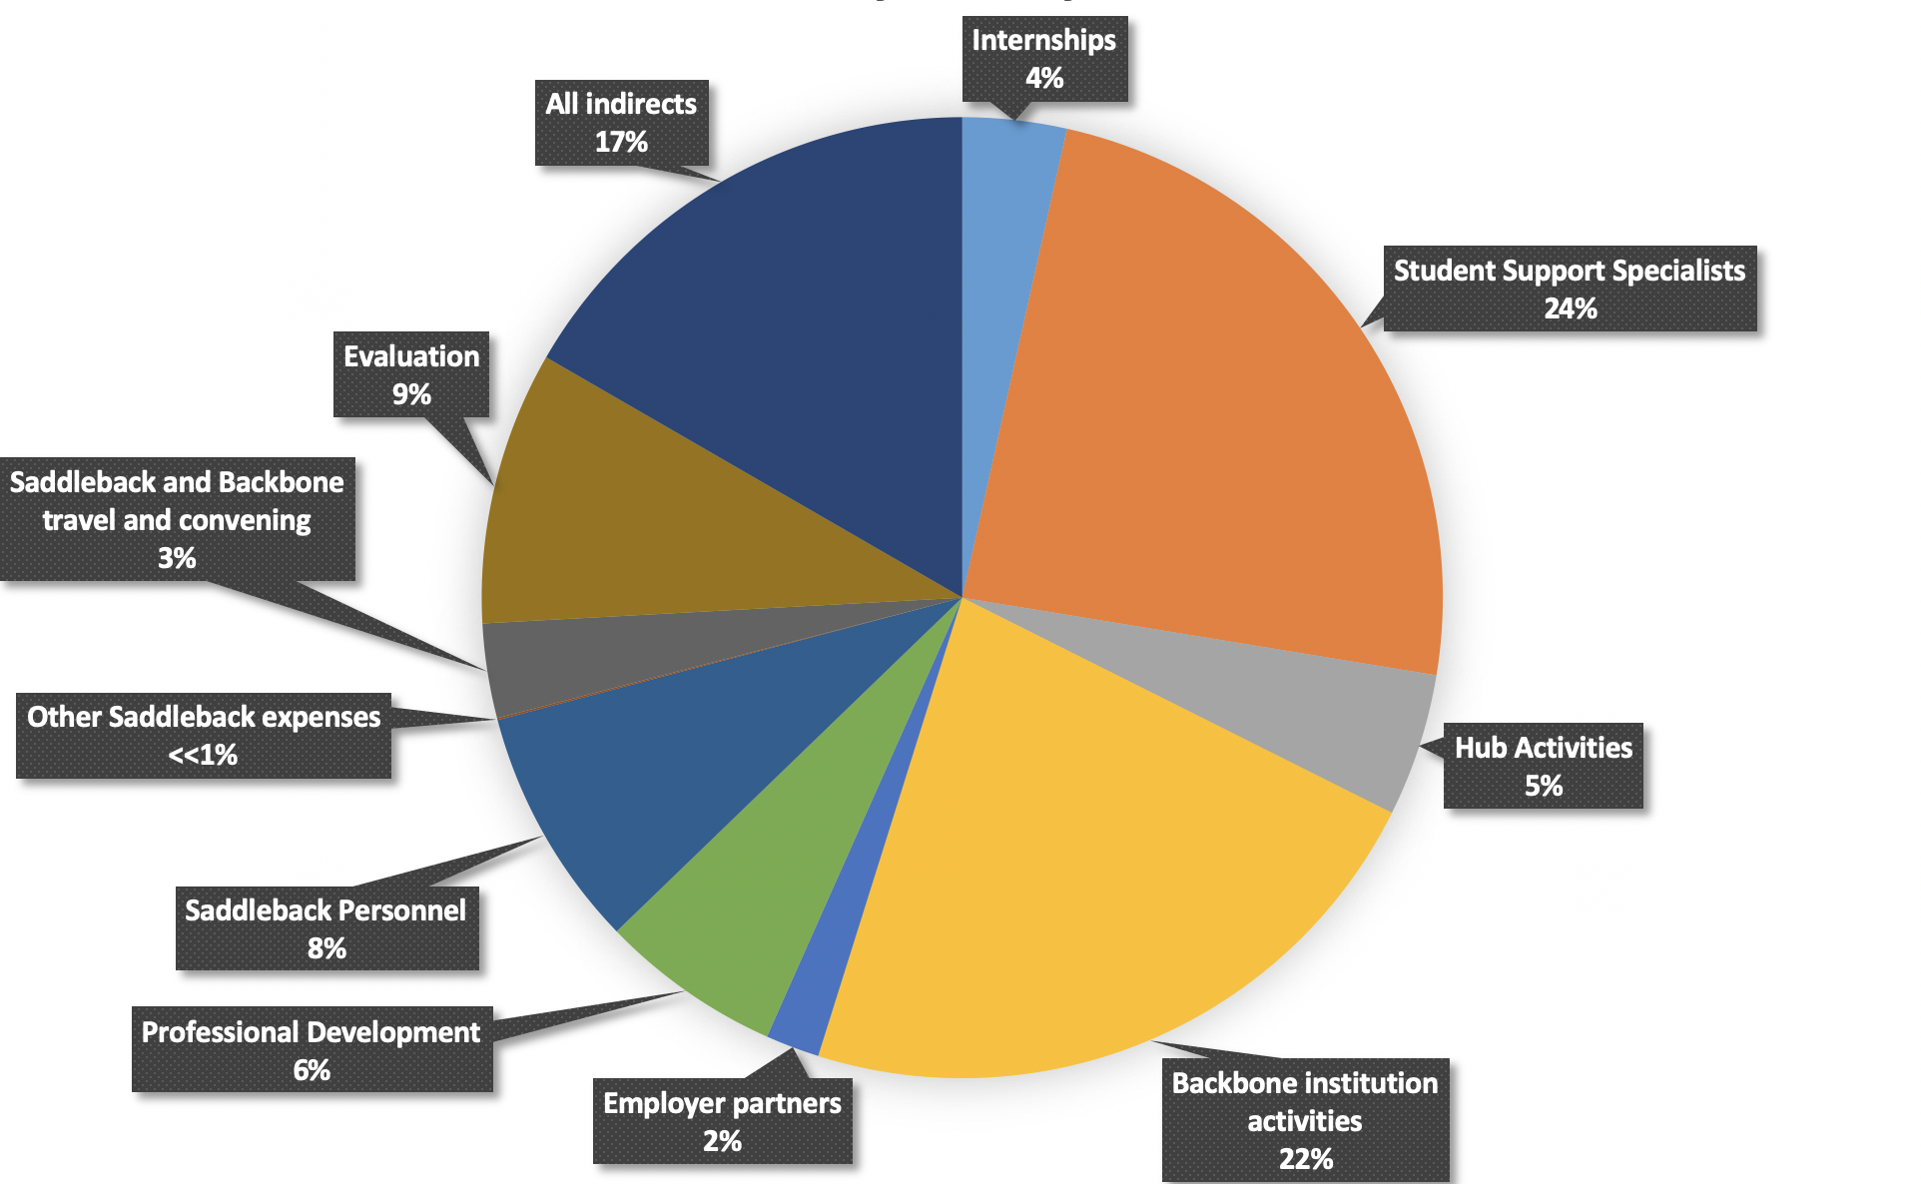
High-Level View of NSF INCLUDES STEM Core Budget Saddleback College
SC Total Budget =
$ 8,819,760
JZ
Notes:
Presenters: Jim Zoval

Slide 27
CONCLUSION OF SESSION 1
JZ
Notes:
Presenters: Jim Zoval

Slide 28
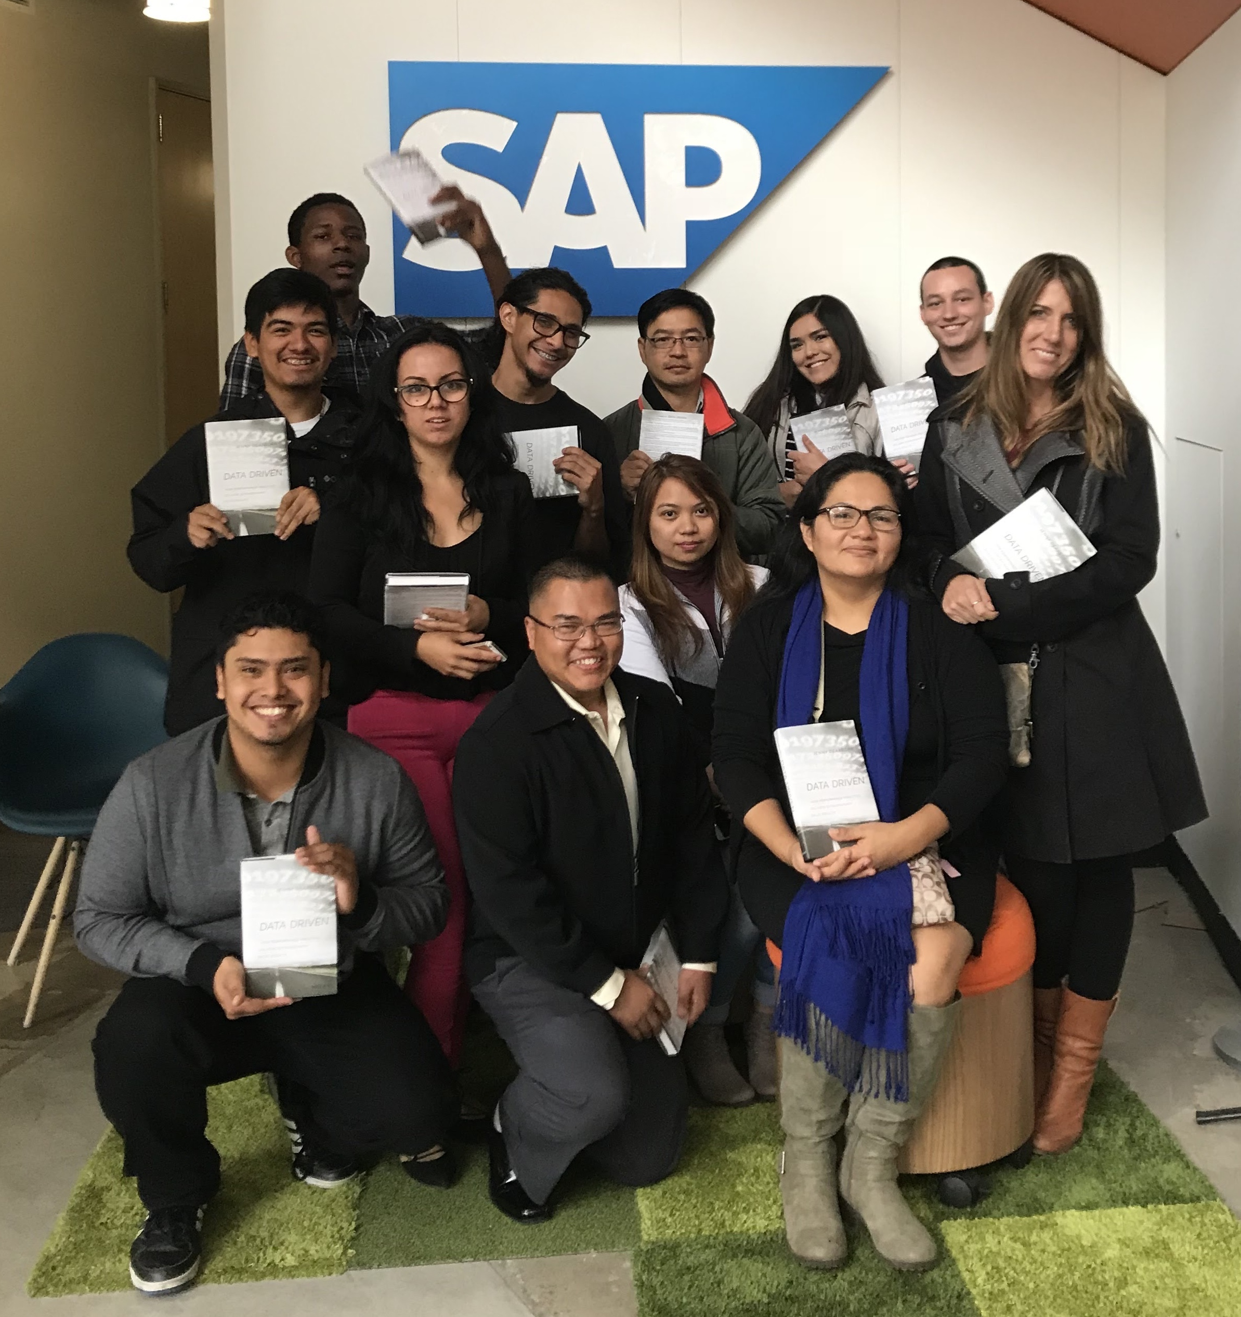
SESSION 2
Goals, Metrics, and Evaluation
JZ
Notes:
Presenters: Jim Zoval

Slide 29
Goals and Metrics
Major goals of the Alliance are to improve practice related to providing access to STEM education and employment for thousands of underprepared community college students through a networked improvement community approach.
I) Research and Evaluation
II) Alliance Coordination
III) Alliance Communication
IV) STEM Core Implementation
JZ
Notes:
Presenters: Jim Zoval

Slide 30
Goals and Metrics
Slides and Handout Annotation Legend:
or = done and will continue doing
or = not completed yet, but expect to complete in the NSF INCUDES Alliance timeframe
*
*
JZ
Notes:
Presenters: Jim Zoval

Slide 31
Goals and Metrics
Slides and Handout Annotation Legend:
or = done and will continue doing
or = not completed yet, but expect to complete in the NSF INCUDES Alliance timeframe
*
*
SC = Saddleback College
GS = Growth Sector (our Backbone Organization)
JZ
Notes:
Presenters: Jim Zoval

Slide 32
Goals and Metrics
I) Research and Evaluation
Objective/Goal: Collecting data on implementation and student outcomes
Deliverable/Metric: Data systems will be in place with clear guidelines regarding data definitions, file formatting and layout, etc.
JZ
Notes:
Presenters: Jim Zoval

Slide 33
Goals and Metrics
I) Research and Evaluation
Objective/Goal: Collecting data on implementation and student outcomes
EXAMPLE: Collecting data on the number of students served:
Fifteen schools had YR1 STEM Core cohorts with a total of 1,286 students.
See handout for footnotes
JZ
Notes:
Presenters: Jim Zoval

Slide 34
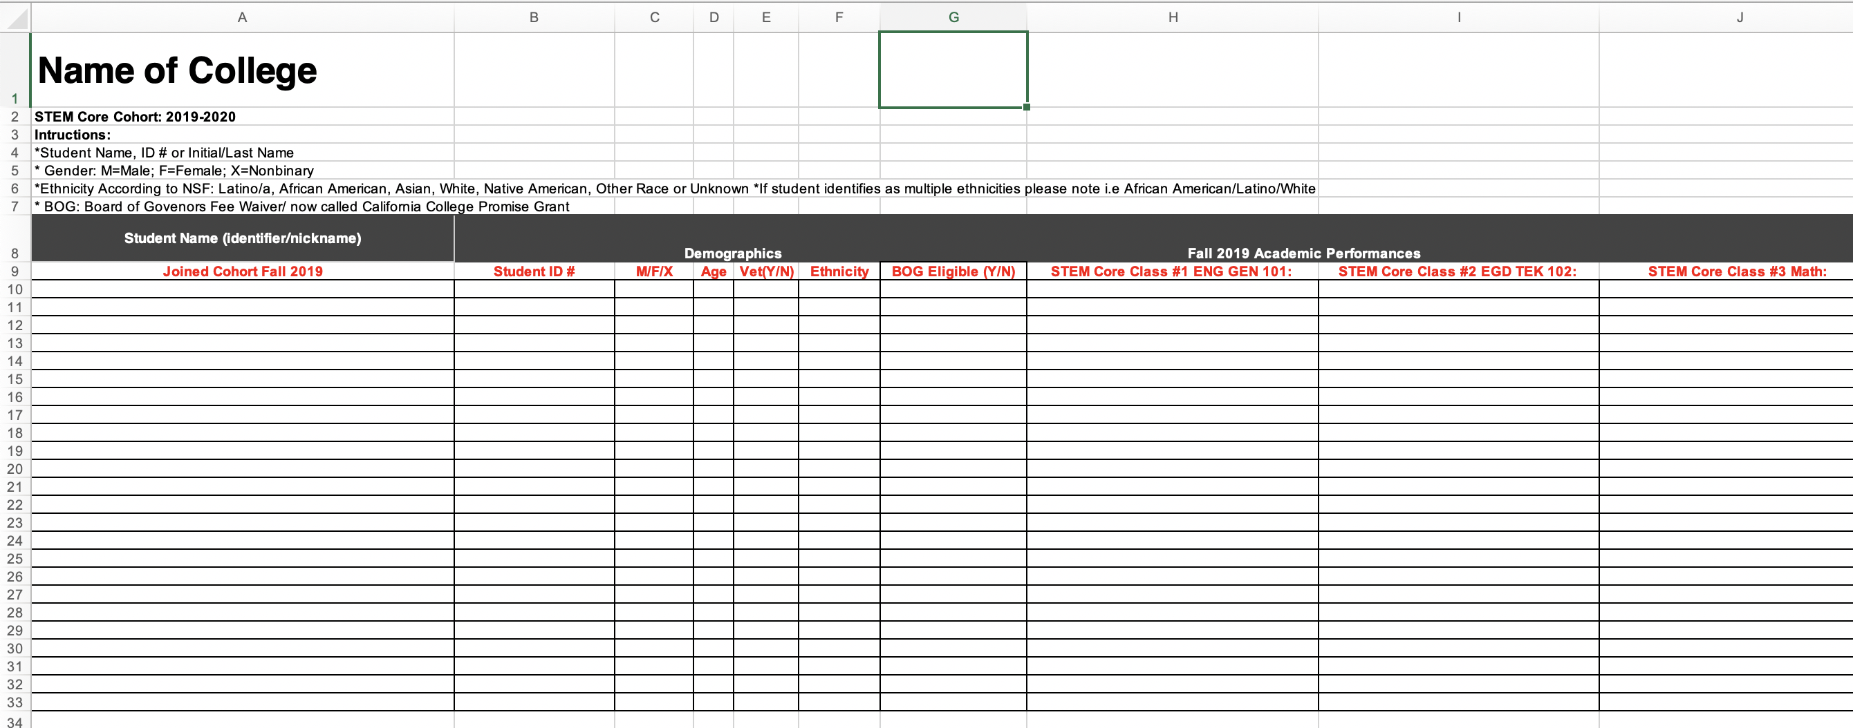
Goals and Metrics
EXAMPLE: Network-wide collection of student demographics
JZ
Notes:
Presenters: Jim Zoval

Slide 35
Goals and Metrics
EXAMPLE: Network-wide collection of student demographics
Women 36%
Students of Color 47%
Economically Disadvantaged (Pell Grant Eligible, YR 2) 52%
JZ
Notes:
Presenters: Jim Zoval

Slide 36
Goals and Metrics
EXAMPLE: Network wide collecting of student calculus readiness.
% of Students Becoming Calculus Ready
69% of our STEM Core student participants became calculus ready in the first year of the Alliance Program. That value can be compared to only 4% of remedial California CC students (CCCCO Data Mart)who become calculus ready within their entire stay at the CC level.
Percent
STEM Core
Students
California CC
Students
JZ
Notes:
Presenters: Jim Zoval

Slide 37
Goals and Metrics
EXAMPLE: Ohlone College (2015-2019) math course success rates
JZ
Notes:
Presenters: Jim Zoval

Slide 38
Goals and Metrics
EXAMPLE: Ohlone College (2015-2019) math course success rates
Preliminary Ohlone College data also shows that success rates, while still high (40%), decrease for courses that come after the program (calculus II).
The data also shows that STEM Core students who are not successful in their first attempt at Calculus II are taking the course again.
For example, in one cohort, 76% of the STEM Core students who completed Calculus I also completed Calculus II, but some required multiple attempts.
JZ
Notes:
Presenters: Jim Zoval

Slide 39
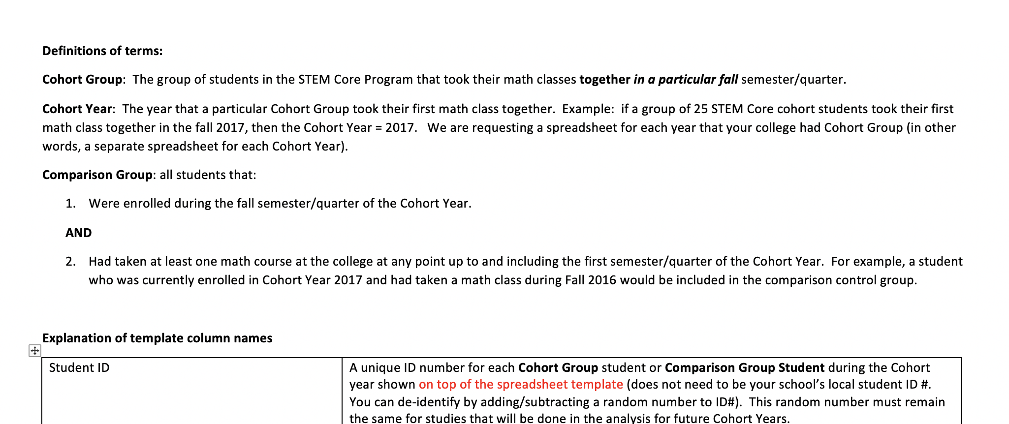
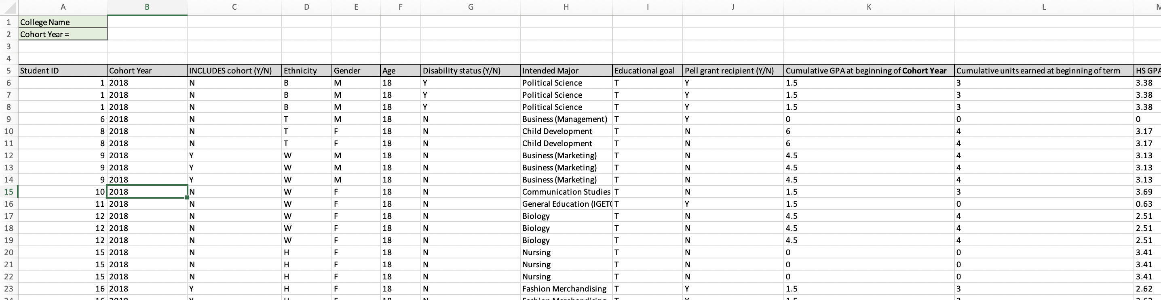
Goals and Metrics
EXAMPLE: Collection of student academic data including propensity matching comparison group
JZ
Notes:
Presenters: Jim Zoval

Slide 40
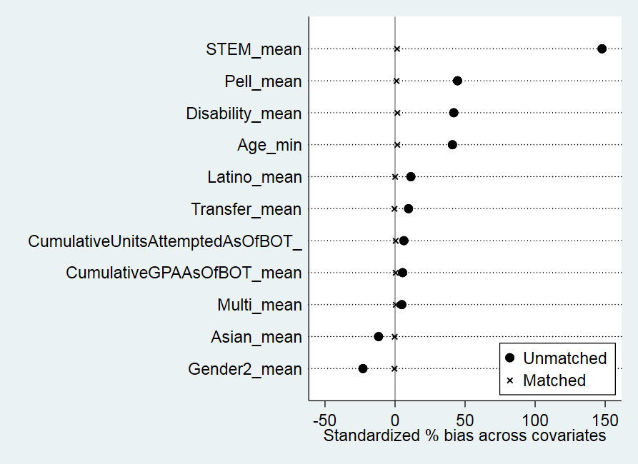
Goals and Metrics
EXAMPLE: Collection of student academic data including propensity matching comparison group
Student Academic Data Analysis for Saddleback Fall 2017 and Fall 2018 INCLUDES Students
Differences in covariates between INCLUDES and non-INCLUDES students before and after propensity score matching.
JZ
Notes:
Presenters: Jim Zoval

Slide 41
Goals and Metrics
EXAMPLE: Collection of student academic data including propensity matching comparison group
Student Academic Data Analysis for Saddleback Fall 2017 and Fall 2018 INCLUDES Students
Academic Data Analysis Summary: INCLUDES cohort students, including females, Latinos, and economically-disadvantaged students, were more than 5 times more likely to become calculus-ready than were propensity score matched non-cohort students. These same INCLUDES cohort students had higher math course grades than did propensity score matched non-cohort students.
JZ
Notes:
Presenters: Jim Zoval

Slide 42
Goals and Metrics
EXAMPLE: Collecting data on participation in internships
JZ
Notes:
Presenters: Jim Zoval

Slide 43
Goals and Metrics
EXAMPLE: Collecting data on participation in internships
The following placements were made for summer 2019 internships:
SLAC National Accelerator: 16 interns (12 Ohlone, 2 Mission, 2 Skyline)
Lawrence Livermore National Lab: 12 interns, (10 Las Positas, 2 Ohlone)
Northrop Grumman: 10 interns (5 Santa Ana, 5 Saddleback)
UC Berkeley Transfer to Excellence Research Program: 1 intern (Skyline)
Lam Research: 2 interns (Ohlone and Las Positas)
City of Pleasanton, City Planning Office (Civil Engineering): 1 intern (Ohlone)
Varian Medical Systems: 1 (Ohlone)
Silicon Valley Bank (Cybersecurity): 1 (San Jose City College)
MECU Credit Union: 1 (CCBC)
Modus: 1 (Las Positas)
Hathaway Dinwiddie: 1 (Las Positas)
JZ
Notes:
Presenters: Jim Zoval

Slide 44
Goals and Metrics
EXAMPLE: Collecting data on participation in internships
The following placements were made for summer 2019 internships:
SLAC National Accelerator: 16 interns (12 Ohlone, 2 Mission, 2 Skyline)
Lawrence Livermore National Lab: 12 interns, (10 Las Positas, 2 Ohlone)
Northrop Grumman: 10 interns (5 Santa Ana, 5 Saddleback)
UC Berkeley Transfer to Excellence Research Program: 1 intern (Skyline)
Lam Research: 2 interns (Ohlone and Las Positas)
City of Pleasanton, City Planning Office (Civil Engineering): 1 intern (Ohlone)
Varian Medical Systems: 1 (Ohlone)
Silicon Valley Bank (Cybersecurity): 1 (San Jose City College)
MECU Credit Union: 1 (CCBC)
Modus: 1 (Las Positas)
Hathaway Dinwiddie: 1 (Las Positas)
2019 Total: 47 internships
JZ
Notes:
Presenters: Jim Zoval

Slide 45
Goals and Metrics
EXAMPLE: Collecting data on participation in internships
The following placements were made for summer 2019 internships:
SLAC National Accelerator: 16 interns (12 Ohlone, 2 Mission, 2 Skyline)
Lawrence Livermore National Lab: 12 interns, (10 Las Positas, 2 Ohlone)
Northrop Grumman: 10 interns (5 Santa Ana, 5 Saddleback)
UC Berkeley Transfer to Excellence Research Program: 1 intern (Skyline)
Lam Research: 2 interns (Ohlone and Las Positas)
City of Pleasanton, City Planning Office (Civil Engineering): 1 intern (Ohlone)
Varian Medical Systems: 1 (Ohlone)
Silicon Valley Bank (Cybersecurity): 1 (San Jose City College)
MECU Credit Union: 1 (CCBC)
Modus: 1 (Las Positas)
Hathaway Dinwiddie: 1 (Las Positas)
Northrop Grumman extended offers for continued employment to all ten interns.
JZ
Notes:
Presenters: Jim Zoval

Slide 46
Goals and Metrics
I) Research and Evaluation
Objective/Goal: Implementation Analysis and Learning to Improve
Deliverables: White papers
STEM Core website
Conference presentations
Published research papers
JZ
Notes:
Presenters: Jim Zoval

Slide 47
Goals and Metrics
I) Research and Evaluation
Objective/Goal: Implementation Analysis and Learning to Improve
Deliverables: White papers
STEM Core website
Conference presentations
Published research papers
EXAMPLES of “Plan-Do-Study-Act” (Continuous Improvement):
STEM Core Annual National Convening improvement using evaluation survey data
Student Support Specialist professional development using student survey data
Math/Science instructor professional development using student survey data
JZ
Notes:
Presenters: Jim Zoval

Slide 48
Goals and Metrics
I) Research and Evaluation
Goal/Objective: Implementation of an External Evaluation
Deliverables: Quarterly debriefs where the backbone and hub leads will provide formative feedback. Activities and findings are shared with National Coordination Hub, the NSF INCLUDES community, and a researcher conference.
Kea Anderson, our Evaluation Team Lead, will discuss the project evaluation progress at the end of this session.
JZ
Notes:
Presenters: Jim Zoval

Slide 49
Goals and Metrics
II) Alliance Coordination
Objective/Goal: Implementation of Organizational Activities
Deliverables: Partner contracts in place by the end of Year 1.
Subrecipient monitoring procedures are in place.
SC holds monthly operational meetings.
JZ
Notes:
Presenters: Jim Zoval

Slide 50
Goals and Metrics
II) Alliance Coordination
Objective/Goal: Implementation of Backbone Activities
Deliverables: Annual national convenings are held with 100-150 participants per year.
One new region and three new community colleges per year consider implementation of the STEM Core model.
JZ
Notes:
Presenters: Jim Zoval

Slide 51
III) Alliance Communication
Objective/Goal: Distribution of Materials and Information
Deliverables: Monthly operational meetings
Quarterly regional PD or other meetings
JY
Notes:
Presenter: Janet Yowell
Activities: SC develops Alliance website, information and document repository, implements a project management system (basecamp), and collaborates with all partners to ensure they have access to information and are able to contribute meaningfully to Alliance dialogue.

Slide 52
Goals and Metrics
III) Alliance Communication
Objective/Goal: Implementation of Alliance Meetings
Deliverables: Quarterly regional PD or other meetings
Annual convenings are hosted by a different regional hub each year
JY
Notes:
Presenter: Janet Yowell
Activities: GS works with partners to schedule regional activities and annual convenings.

Slide 53
Goals and Metrics
III) Alliance Communication
Objective/Goal: Implementation of Hub Coordination
Deliverables: PI meeting discussions (Changed to: Hub Coordinators provide HUB activity quarterly reports to PI)
JY
Notes:
Presenter: Janet Yowell
Activities: Hubs support college implementation and participation in PD and other networking opportunities

Slide 54
Goals and Metrics
IV) STEM Core Implementation
Objective/Goal: Provide Support for the Model
Deliverables: Implementation of objective's activities is complete or ongoing.
Trained student support specialists manage all STEM Core cohorts.
JY
Notes:
Presenter: Janet Yowell
Activities: GS and Coordination Hubs provide individual college-level support for model implementation as necessary. GS trains and coordinates the work of all student support specialists.
resenters: Jim Zoval

Slide 55
Goals and Metrics
IV) STEM Core Implementation
Objective/Goal: Implementation of Professional Development Programs
Deliverable: Sixty faculty and counselors participate in professional development in Year 1, 100 in Year 2, and 200 per year in each subsequent year.
Pathways to Calculus training was also provided by UT Austin’s Charles A. Dana Center
JY
Notes:
Presenters: Janet Yowell
Activity: SJECCD’s Center for Economic Mobility and Stanford’s youcubed program provide professional development for faculty and counselors

Slide 56
Goals and Metrics
Progress to Date Relative to the Logic Model, Intellectual Merit and Broader Impacts of the Alliance
JZ
Notes:
Presenters: Jim Zoval

Slide 57
Goals and Metrics
Progress to Date Relative to the Logic Model, Intellectual Merit and Broader Impacts of the Alliance
Footnote legend for the Logic Model, Intellectual Merit, and Broader Impacts paragraphs (in your handout):
= done and will continue doing
= not completed yet, but expect to complete in the NSF INCUDES Alliance timeframe
*
*
JZ
Notes:
Presenters: Jim Zoval

Slide 58
Evaluation
KA
Notes:
Presenter: Kea
Goals and Audiences for the External Evaluation
We see four types of audiences for the external evaluation findings.
The STEM Core Alliance needs formative findings to support continuous improvement and network growth
The approach and findings from evaluating a large-scale collaborative change initiative to broaden participation in STEM can help build knowledge in the NSF INCLUDES community and among others interested in BP / advancing equity and access
We envision partnering with STEM Core to share combined findings (from the external eval and the Alliance’s own research) with these last two audiences

Slide 59
Evaluation
External Evaluation Goals and Audiences
Provide the STEM Core Alliance formative and summative feedback on implementation, scale, and continuous improvement strategies
Share approach and findings with the NSF INCLUDES National Network and field
Inform policymakers and community college leaders on strategies for preparing more students to meet state and regional workforce needs
Inform industry leaders on designing successful internship programs to improve equity and diversify workforce
KA
Notes:
Presenter: Kea
Goals and Audiences for the External Evaluation
We see four types of audiences for the external evaluation findings.
The STEM Core Alliance needs formative findings to support continuous improvement and network growth
The approach and findings from evaluating a large-scale collaborative change initiative to broaden participation in STEM can help build knowledge in the NSF INCLUDES community and among others interested in BP / advancing equity and access
We envision partnering with STEM Core to share combined findings (from the external eval and the Alliance’s own research) with these last two audiences

Slide 60
Evaluation
Evaluation Questions
What supports, constraints, and variation exist in STEM Core community college partners?
To what extent does the STEM Core model develop to its intended scale (e.g., depth, sustainability, spread, and shift in ownership)? What resources, supports, and conditions facilitate these shifts?
Does the STEM Core network continuously improve to adapt to the needs of the growing community of network members?
KA
Notes:
Presenter: Kea
Evaluation Questions
The evaluation questions address (1) the model, (2) how the model scales, and (3) how the networked improvement community approach used to enrich and extend the model serves the project’s goals.
The questions are closely related, with dovetailing data sources and indicators. For example, resources to support sustainability at participating community colleges are part of site variation (EQ1), as well as a support for scale (EQ2) and may support network growth and health (EQ3). Similarly, we will account for variation in the ways each regional hub supports a subset of community colleges as part of characterizing implementation across sites, while in EQ3 (network growth and health), we will more deeply explore the hubs’ strategies in supporting continuous improvement for a set of network nodes. In this way, answering the first question lays some of the groundwork for responding to the other two questions.
[INTERNAL NOTE: This question originally asked about how the network scaled but I think it works much better to ask how the model scales, since the model is the ed intervention (making the Coburn frame fit better) and since EQ3 is about network growth and health.]

Slide 61
Evaluation
What supports, constraints, and variation exist in STEM Core community college partners?
Student demographics, student academic and internship outcomes
Presence and nature of STEM Core model elements
Presence of non-STEM Core resources to support implementation, e.g., funding, partnerships
Role of respective Hubs in supporting implementation
KA
Notes:
Presenter: Kea
Question 1
To answer this question, are studying and characterizing variation in the STEM Core model that Jim described earlier [recap it] across participating colleges.
This includes investigation of supports and barriers to full implementation as well as trying to capture what we might consider “productive variation” or innovation.
We are also considering the presence and nature of culturally responsive approaches and growth-mindset perspective in serving under-prepared students and students from groups underrepresented in STEM.
As part of this descriptive exercise, we are also gathering data on implementation that will help us respond to the next two questions, such as contextual factors that support sustainability (alignment of model to institutional needs, resources from other sources)
These are examples of indicators associated with this question. [PROVIDE FULL LIST IN HANDOUT?]

Slide 62
Evaluation
2. To what extent does the STEM Core model develop to its intended scale (e.g., depth, sustainability, spread, and shift in ownership)? What resources, supports, and conditions facilitate these shifts?
PD principles reflected in faculty, counselor, and student support specialist attitudes and practices
Degree to which STEM Core model is institutionalized at participating community colleges
Degree to which participating community colleges take ownership, sustain the model over time
KA
Notes:
Presenter: Kea
Question 2
This question takes the STEM Core model as an education intervention and examines scale generally using the elements and definitions proposed by Coburn (2003).
To answer it, we will consider some Q1 findings through a different analytic lens, and also collect and analyze some different data. We will draw on Q1 findings regarding the influence of STEM Core PD on changes in attitudes and practice [PD being an element of the model] but focus more here on change over time, examining things like the degree to which CCs institutionalize the model, as evidenced by policy and practice to support it, use of the model to address other STEM BP or related challenges, and faculty and counselors becoming proponents of the PD principles (growth mindset, culturally responsive practices).

Slide 63
Evaluation
3. Does the STEM Core network continuously improve to adapt to the needs of the growing community of network members?
Network leadership strategies by Alliance, hubs, other emerging leaders
Nature of network node contributions
Use of improvement infrastructure, e.g., meetings, Basecamp
Changes in implementation/strategy resulting from improvement cycles
KA
Notes:
Presenter: Kea
Question 3
This question focuses on how the Alliance enacts its networked improvement community, examining aspects including:
Presence and nature of improvement cycles
**overall network growth (gain as well as loss of nodes, partners)
network leadership strategies on the part of the Alliance, hubs, and other emerging leaders
nature of network node contributions
use of improvement infrastructure
and changes in implementation / strategy resulting from improvement cycles

Slide 64
Evaluation
Data Sources
Student Support Specialist survey
Student outcomes data
PD participant survey
Convening participant survey
Literature and document review
Interviews
Observations
KA
Notes:
Presenter: Kea
Data sources
In collaboration with STEM Core, we will rely on:
data from a Student Support Specialist survey, administered to every site [ANNUALLY?] that provides data on implementation characteristics
analysis of student outcomes data
PD participant survey data
Convening participant survey data
The other main data sources are interviews (with Alliance leaders; with community college participants, including focus groups with students; with industry / workforce partners) and observation (at community colleges during site visits and at hub and Alliance meetings)

Slide 65
Evaluation
Status of Data Collection and Analysis
Analyzed Annual STEM Core Convening participant survey data
Completed 31 interviews, most conducted during 5 site visits
Completed observations during site visits, of hub meetings, PD events, and Convening
KA
Notes:
Presenter: Kea
Completed 31 interviews, most conducted during 5 site visits:
14 with Pacific NW Hub CCs and partners
7 with DC Metro Hub partners (at 2 CCs, workforce partner)
4 with 2 SoCal Hub CCs
A few with STEM Core Alliance leadership
Conducted observations at:
Site visits (of courses)
A few PD meetings [ADD DETAILS]
A few hub meetings
One national Alliance meeting
We shared two analysis memos from site visits with the team via Basecamp and have shared preliminary findings in our annual report in September and are now developing the coding scheme to analyze interview and observation data gathered thus far.

Slide 66
Evaluation
Developing a Detailed Evaluation Plan
Confirming sites and participants
Understanding implementation stages to inform site visit sampling strategy
Identifying interview sample criteria, subset of annual interviews
Reviewing protocols
KA
Notes:
Presenter: Kea
Developing a detailed evaluation plan
Partly based on what the team learned in Year 1, and partly occasioned by our change in evaluation lead, we’ve been refining the proposed evaluation approach into a detailed evaluation plan.
We’re working with STEM Core to gather some background information that will help us develop a clearer sampling strategy for site visits and interviews, including the optimal range of implementation stages we can productively visit, and criteria for identifying a subset of sites and participants for annual interviews. So, while I can tell you how many interviews we’ve completed, I’m not yet in a position to say what portion of a total this reflects, nor which of these we plan to follow up with or when.
We will also be able to review results from the Student Support Specialist survey within a few weeks.
[INTERNAL NOTE: I can say more about challenges or save that for Q&A, for instance our misfires in reaching out to sites that aren’t yet implementing, miscommunication around the timing of meetings or lack of timely invites.

Slide 67
Evaluation
Opening Stronger Lines of Communication
Interdependence calls for close collaboration between Alliance and evaluation.
Collaborating to clarify…
Alliance information needs and most helpful types of formative feedback
Deliverable formats and deadlines align with needs
KA
Notes:
Presenter: Kea
Opening stronger communication lines between Alliance leadership and evaluation
Close communication is particularly key given the interdependence built into our role – of contributing to a continuous improvement process we’re also studying, and of drawing on Alliance research and analysis in the evaluation.
In discussing the draft evaluation plan, we are working with STEM Core to understand what kinds of formative feedback they would find most helpful, and to ensure the design and deliverable dates and types align with their information needs.

Slide 68
Evaluation
Preliminary Findings: Implementation Variation
Variations in Implementation | Local Drivers of Variation
Student access to paid internships | College-secured funding; distance/difficulty of access; regional employer needs
Students’ goals for transfer to 4-year colleges | State variation in quality of articulation agreements
Wraparound student supports | Student resident or commuter status, SSS position funding status, other student needs
Accelerated math sequences | Range of student preparation, faculty specialty, availability of specialized equipment
Program length | Articulation agreement requirements, institutional commitment after first full year of implementation
KA
Notes:
Presenter: Kea
Related to our first evaluation question, ere are some of the ways implementation varies site to site, based on preliminary review of site visit data, and what we think drives local variation. [Talk through slide – drawn from SRI’s annual report, table on p. 13]

Slide 69
Evaluation
Preliminary findings: NIC
2019 Annual Convening: Observation
High participant engagement, appreciation for in-person gathering
Networking across nodes in various hubs, sharing of implementation strategies, resources, and ideas
Interest in improving access to internships through relationship-building, identifying needed skills
KA
Notes:
Presenter: Kea
[Talk through slide, drawn from annual report]

Slide 70
Evaluation
Preliminary findings: NIC
2019 Annual Convening: Survey Analysis
Participant goal: learn best practices for supporting SC students, network with industry partners and peers
Challenges noted by administrators: funding, recruiting students, access to internships
Challenges noted by faculty: inadequate time, recruiting and retention, developing working relationship with Student Support Specialists
KA
Notes:
Presenter: Kea
[Talk through slide, drawn from annual report]

Slide 71
Significant Barriers and Challenges
1) Funding Student Support Specialists
2) Funding Paid Student Internships
3) Obtaining Deidentified Student Academic Data from Some Partner Colleges
4) Post Community College Participant Data Tracking
JZ
Notes:
Presenters: Jim Zoval

Slide 72
CONCLUSION OF SESSION 2
JZ
Notes:
Presenters: Jim Zoval

Slide 73
Connecting to the National Network
Building and strengthening capacity for leadership and communication among collaborating organizations and individuals:
Contributed to the Journey to an Alliance webinar series hosted by the Coordination Hub for all Network members (March 26, 2019)
STEM Core evaluators participate in the Network’s Evaluation Affinity Group and have exchanged resources and best practices, for example those related to developing theories of change for complex networked endeavors
STEM Core coordinated with Coordination Hub team to identify NSF INCLUDES DDLPs and others whose work intersects with STEM Core’s model for possible invitations to the 2020 STEM Core Network Convening.
Attended the Network kick-off meeting at NSF (October 3, 2018), where the team mapped Network assets and engaged with other Alliances and NSF
Met with Alliance leadership at the National Network Convening, resulting in new partnership with SF State.
Participate in regular calls and online group for Alliance backbone leadership
Participate in bimonthly calls and new online group of Alliance leaders
JZ
Notes:
Presenters: Jim Zoval

Slide 74
Connecting to the National Network
How the Alliance connects and contributes to the Coordination Hub and the National Network, and vice-versa:
STEM Core Sr. Personnel participated in the Network’s STEM Pathways Affinity Group and have discussed resources and best practices.
STEM Core Sr. Personnel attended the 2019 National Network Convening (May 28-29, 2019), where team members engaged with other grantees and funders, met with Alliance leadership, and continued conversations around shared measures. As a result of those conversations, STEM Core developed a new partnership with CAHSI Alliance partner San Francisco State University.
Meet monthly with a Hub team Alliance liaison (Hub Deputy Director) to discuss results and plans. STEM Core Sr. Personnel provide Coordination Hub with reporting and communications products so Coordination Hub can help share STEM Core results across the Network and via Twitter on @INCLUDESHub.
Secured introduction from Coordination Hub team and met with Indigenous STEM Affinity Group leaders David Mays and Timberley Roane to discuss supporting Native students’ STEM trajectories (September 2019).
JZ
Notes:
Presenters: Jim Zoval

Slide 75
Connecting to the National Network
How and where outcomes have been or will be disseminated
Met with the Coordination Hub team to review and discuss STEM Core outcomes in order to inform the Hub’s planning related to the Network’s shared measures framework (May 2019)
Provided a STEM Core outcomes document to the Coordination Hub in order to help build the Network’s shared measures framework
Contributed a blog post to the National Network website about its 2019 National Convening (posted on INCLUDESNetwork.org April 8, 2019)
Provided permission for STEM Core video to be featured on Network website and in other Hub-led engagement campaigns
Worked with the Hub team to feature an anecdote about new STEM Core partnerships with New Mexico high schools, colleges, and NM- and CA-based National Laboratories in the “Stories from Across the National Network” document prepared for a Dec 2, 2019 meeting with NSF Director Dr. France Còrdova
Shared materials with Coordination Hub about paid internships program for them to use in discussions with DC-area industry connections
JZ
Notes:
Presenters: Jim Zoval

Slide 76
Connecting to the National Network
Plans for future activities, with specific emphasis on efforts to achieve the long-term sustainability of this investment:
Growth Sector is partnering with DDLP recipient North Carolina A+T (NCAT) in expanding the STEM Core model to NCAT feeders Forsythe Community College and Guilford Community College.
Goal is to expand the pool of developmental students pursuing engineering degrees at NCAT through an integrated work learning program combining pursuit of a B.S. pathway with paid internships.
Part of a larger initiative sponsored by the Department of Energy National Nuclear Security Administration (NNSA) to expand the pool of students at minority serving institutions pursuing careers in engineering and computer science at NNSA labs.
Other partners include New Mexico State University, Navajo Tech, Dona Ana and Central New Mexico community colleges, and Los Alamos, Sandia, and Oak Ridge national labs.
Accepted invitation to give a keynote talk at First 2 Network Alliances, May 12-13 Event
JZ
Notes:
Presenters: Jim Zoval

Slide 77
STEM Core’s Own Network Communication
Saddleback College
Jim Zoval, PI/Alliance Director
Art Nitta, Co PI
University of Colorado Boulder
Janet Yowell, PI
Backbone Organization
Dave Gruber and
Caz Pereira, Directors
SSS training, securing internships, adding college partners, high school dual credit, and program institutionalization
Professional Development for
Faculty and Counselors
(Stanford)
NSF / Alliance HUB
Communications
Evaluation Team
Develop the data infrastructure to monitor and respond to emerging network needs and monitor data for continuous improvement.
(Saddleback and Growth Sector)
Professional Development
Academic
Publications
Web Site Programmatic Content and Function
Social Media
Content and Function
Backbone Institute
Dissemination of Information to STEM Core HUBS and other Partners
STEM Core Hubs, Evaluation Team, College Partners, Student Participants, General Public
STEM Core HUBS
Dissemination of Information to Participant Colleges

Slide 78
Conclusion of Session 3
If Panel wishes, and time allows:
Growth Mindset vs. Fixed Mindset
https://www.youtube.com/watch?v=KUWn_TJTrnU
A Student’s Story
https://www.youtube.com/watch?v=B0Iv7uZsb48
JZ

